Slide 1

A/R Part 2 – In-Class

Slide 2
Sales Discounts Offer a discount as incentive for customer to pay early Record using Gross or Net Method

Slide 3

Sales Discount
Discount offered to customers for early cash payment on A/R
Usually presented in terms such as: 2/10, n/30
2% discount if paid within 10 days,
all else due in 30 days.
Discount is not all or nothing: Customer can pay for part of order early (get discount) and remaining portion later (no discount).
Type of variable consideration: Company does not know exactly when customer will pay – need to estimate (gross method or net method).

Slide 4
Recording Sales Discounts: Gross vs Net
 | Gross Method (assume customer is not taking discount) | Net Method (assume customer is taking discount)
Date of Sale
After Sale
Record revenue and accounts receivable at full sales value (no discount)
Record revenue and accounts receivable at sales value less discount amount
If customer pays early (gets discount)
Debit cash received
Credit A/R for original amount
Debit Sales Discount (I-XR)
If customer pays late (no discount)
Debit cash received
Credit A/R for original amount
If customer pays early (gets discount)
Debit cash received
Credit A/R for original amount recorded
If customer pays late (no discount)
Debit cash received
Credit A/R for original amount recorded
Credit Sales Discount Forfeited (I-R)

Slide 5
Example: Sales Discount (Gross)
Suppose Plankton Co. sells $100 on account with terms 2/10, n/30.
Gross Method
Journal Entries on Date of Sale:
Accounts Receivable (B-A)
100
Revenue (I-R)
100
Customer Pays in 10 Days (discount):
Customer Pays in 30 Days (No discount):
Cash (B-A)
98
Cash (B-A)
100
Sales Discount (I-XR)
2
Accounts Receivable (B-A)
100
Accounts Receivable (B-A)
100

Slide 6
Example: Sales Discount (Net)
Suppose Plankton Co. sells $100 on account with terms 2/10, n/30.
Net Method
Journal Entries on Date of Sale:
Accounts Receivable (B-A)
98
Revenue (I-R)
98
Customer Pays in 10 Days (discount):
Customer Pays in 30 Days (No discount):
Cash (B-A)
98
Cash (B-A)
100
Accounts Receivable (B-A)
98
Accounts Receivable (B-A)
98
Sales Discount Forfeited (I-R)
2

Slide 7
Sales Discount New Accounts
Two New Accounts:
Gross Method: Sales Discounts (If taken) * Contra Revenue
Net Method: Sales Discount Forfeited (If NOT taken) * Revenue

Slide 8
In-Class Problem #1

Slide 9
Sell (Factor) Receivables
Transfer of Receivables
Video: Secured Borrowing
Sell/Factor
Securitize Receivables
Notes:
3 ways to get cash today from A/R
Pledge/assign (collateral)
Factor (sell receivables to 3rd party at a discount)
Securitize (bundle together and sell interest in many separate receivables)
123 of 500 firms in 2009 discuss the use of receivables to obtain financing in their annual reports
102 sold, 11 with recourse, 45 without, 46 don’t discuss recourse
21, receivables used as collateral
The “real world”: 123/500 firms in 2009 discuss the use of receivables to obtain financing in annual reports
102 sold (11 with recourse, 45 without recourse, 46 don’t mention)
21 used as collateral

Slide 10
When is a Transfer a Sale?
Are receivables isolated from the seller?
No
Yes
Does the seller give up effective control over the receivables?
No
Record as secured borrowing
Yes
Does the buyer have the right to pledge or sell the receivables?
No
Yes
Record as a sale
Notes:
Pretty much the seller doesn’t control the receivables in any way.
Receivables are out of the reach of sellers as well as its creditors, even in the case of bankruptcy
The buyer can do whatever they want with the receivables.
There is no agreement for seller to repurchase or redeem before maturity.
Continued involvement: servicing or recourse?

Slide 11
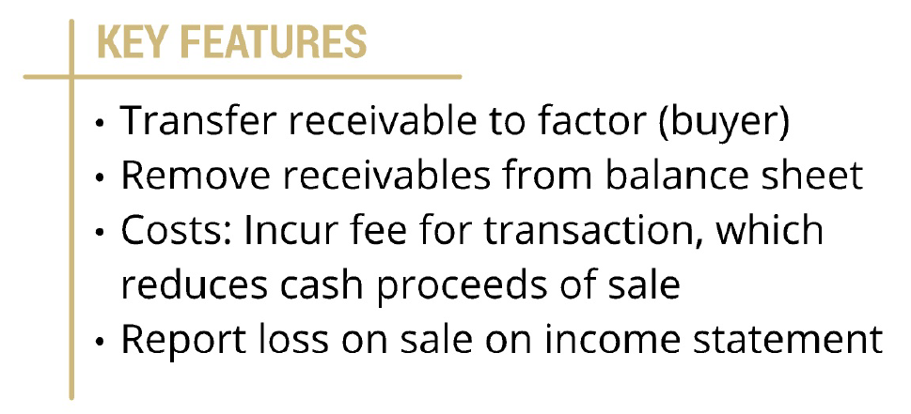
Sale of Receivables (Factoring)

Slide 12
Basic Entry
Harvey Company sells its $80,000 of receivables and is charged a 5% factoring fee. Record the journal entry.
Factoring Fee → Loss on Sale of A/R = 80,000 * 5% = 4,000
Dr. Cash (B-A) 76,000
Dr. Loss on Sale of AR (I-E) 4,000
Accounts Receivable (B-A) 80,000

Slide 13
Two considerations:
Recourse: The Seller guarantees that all of the receivables will be collectible.
Hold Back: The Buyer keeps some cash until receivables are collected, then pays the seller the remaining balance.

Slide 14
What does recourse mean?
Recourse: When the seller guarantees that all or part of receivables can be collected.
Sale with Recourse
Sale without Recourse
Seller assumes risk of uncollectible amounts and subsequent losses.
Seller removes receivable from balance sheet
Seller records additional loss from sale & establishes a liability for the uncollectible amount
Buyer assumes risk of uncollectible amounts and subsequent losses.
Seller removes receivable from balance sheet
Seller records gain or loss from sale (difference in proceeds and face value of receivable)
Notes:
Who incurs bad debt losses?
Recourse: (per WILEY GAAP 2014, p. 1166)
“effect of a recourse provision on…surrender of control provisions may vary by jurisdiction and by the level of recourse provided.”
- full recourse may not place receivables beyond reach of transferor
- some will be sales, some will be secured borrowings

Slide 15
Sale with recourse
If customers default…seller makes buyer whole.
Harvey sells $80,000 of its customer receivables to Leslie with recourse. Leslie charges a 5% factoring fee for this service. It is determined that the recourse obligation related to default risks has a fair value of $3,200.
Factoring Fee → Loss on Sale of A/R: 80,000 * 5% = $4,000
PLUS Additional loss on Sale: $3,200 (For the Recourse → ALSO Record LIABILITY)
= $7,200 Loss on Sale of A/R
Dr. Cash (B-A) 76,000
Dr. Loss on Sale of AR (I-E) 7,200
Cr. Accounts Receivable (B-A) 80,000
Cr. Recourse Liability (B-L) 3,200
$4,000 + $3,200

Slide 16
Hold Backs
What does it mean for a buyer to hold back cash?
The buyer can hold back some of the cash proceeds to cover adjustments to receivables, like sales discounts or sales returns.
Buyer will release cash later to seller less the adjustments.
Accounting:
Cash received is reduced by the amount held back. “Holdback”
Seller records a receivable from the buyer for the held back amount.

Slide 17
Sale with recourse + hold backs
If customers default…seller makes buyer whole.
Harvey sells $80,000 of its customer receivables to Leslie with recourse. Leslie charges a 5% factoring fee for this service and retains 3% in case of sales returns and discounts. It is determined that the recourse obligation related to default risks has a fair value of $3,200.
Factoring Fee → Loss on Sale of A/R: 80,000 * 5% = $4,000
PLUS Additional loss on Sale: $3,200 (For the Recourse → ALSO Record LIABILITY)
= $7,200 Loss on Sale of A/R
Holdback → Receivable from Factor: 80,000 * 3% = 2,400 (They “Holdback” some cash)
Dr. Cash (B-A) 73,600
Dr. Receivable from Factor (B-A) 2,400
Dr. Loss on Sale of AR (I-E) 7,200
Cr. Accounts Receivable (B-A) 80,000
Cr. Recourse Liability (B-L) 3,200
3% of cash gets “held back” and may be received later

Slide 18
Summary of Considerations
Harvey sells $80,000 of its customer receivables to Leslie with recourse. Leslie charges a 5% factoring fee for this service and retains 3% in case of sales returns and discounts. It is determined that the recourse obligation related to default risks has a fair value of $3,200.
ALWAYS write off all A/R: Cr A/R
Factoring Fee → Dr Loss on Sale of A/R
“With Recourse” → Dr More Loss on Sale of AR PLUS Cr Recourse Liability Entry
“Holdback” → Dr Receivable from Factor: Buyer (Factor) Holds back some cash
Finally, Plug a Dr Cash entry

Slide 19
In-class problem #2
Vandelay Corp. (seller) transfers $720,000 of receivables to Dunder Mifflin Financing (factor, buyer) without recourse. The transaction qualifies as a sale for accounting purposes. DMF charges 5% factoring fee (aka finance fee to cover processing costs, default risk, and costs related to the time value of money) and holds back an additional 8% as security. What is Vandelay’s journal entry to record the transaction?
Vandelay Corp. (seller) transfers $720,000 of receivables to Dunder Mifflin Financing (factor or buyer) with recourse. The transaction qualifies as a sale for accounting purposes. DMF charges 5% factoring fee and holds back an additional 8% as security. In addition, the fair value of the recourse liability is estimated at $20,000. What is Vandelay’s journal entry to record the transaction?
Vandelay Corp. borrows $684,000 from Dunder Mifflin Financing by securing a revolving line of credit at a 7% interest rate. Interest is due and payable at the end of each month based on the outstanding balance at the beginning of the month. Vandelay assigned $720,000 of its accounts receivable as collateral for the lending arrangement. There is no finance fee. What is Vandelay’s journal entry to record the transaction?

Slide 20
Closing Thoughts
Sale vs. secured borrowing for transferring
Sale: Remove A/R for sales, deal with recourse and hold backs
Secured Borrowing: Keep A/R for collateralized borrowing. Just a loan.
AR: Sales discounts (Gross vs Net)
Reductions for paying quickly
Assume they will or will not take, correct if you’re wrong

